Slide 1
Executive Summary: Bayes Nets
Andrew W. Moore Carnegie Mellon University,
School of Computer Science awm@cs.cmu.edu
www.autonlab.org
Note to other teachers and users of these slides. Andrew would be delighted if you found this source material useful in giving your own lectures. Feel free to use these slides verbatim, or to modify them to fit your own needs. PowerPoint originals are available. If you make use of a significant portion of these slides in your own lecture, please include this message, or the following link to the source repository of Andrew’s tutorials: http://www.cs.cmu.edu/~awm/tutorials . Comments and corrections gratefully received.
Ice-Cream and Sharks Spreadsheet
Recent Dow- Jones Change | Number of Ice- Creams sold today | Number of Shark Attacks today
UP | 3500 | 4
STEADY | 41 | 0
UP | 2300 | 5
DOWN | 3400 | 4
UP | 18 | 0
STEADY | 105 | 0
STEADY | 4 | 0
STEADY | 6310 | 3
UP | 70 | 0
Copyright © 2002, Andrew W. Moore
Short Bayes Nets: Slide 2

Slide 2
A simple Bayes Net
Common Cause
Ice-Cream Sales
Shark Attacks
Copyright © 2002, Andrew W. Moore
Short Bayes Nets: Slide 3
A bigger Bayes Net
Weather
Is it a Weekend?
Number of People on Beach
Fish Migration Info
Ice-Cream Sales
Shark Attacks
These arrows can be interpreted…
Causally (Then it’s called an influence diagram)
Probabilistically (if I know the value of my parent nodes, then knowing
other nodes above me would provide no extra information: Conditional Independence
Copyright © 2002, Andrew W. Moore Short Bayes Nets: Slide 4

Slide 3
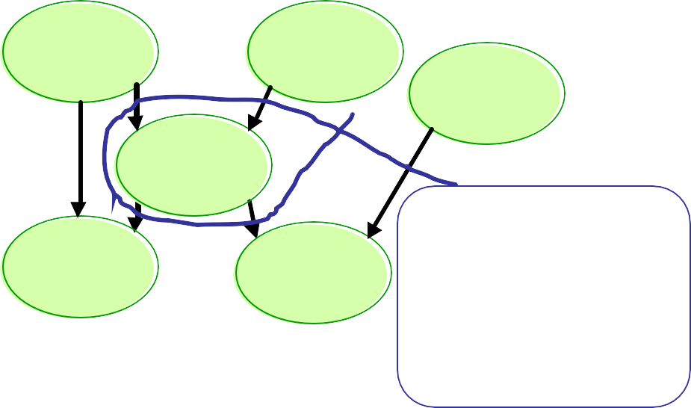
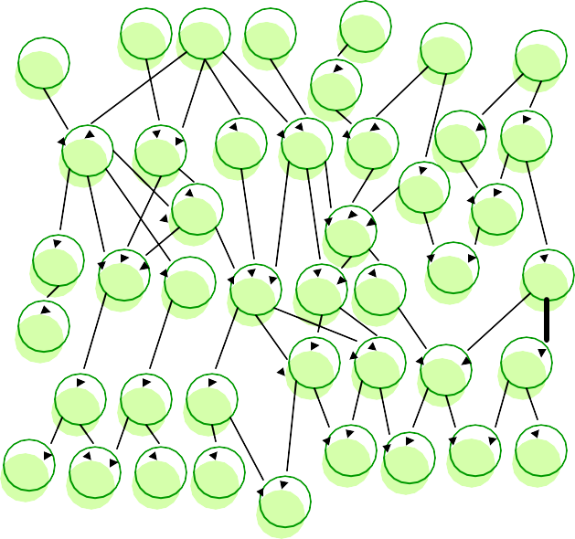
The Guts of a Bayes Net
Weather
Is it a
Weekend?
Fish Migration Info
Number of People on Beach
If Sunny and Weekend then
Prob ( Beach Crowded ) = 90%
If Sunny and Not Weekend then
Prob ( Beach Crowded ) = 40%
If Not Sunny and Weekend then
Prob ( Beach Crowded ) = 20%
If Not Sunny and Not Weekend then
Prob ( Beach Crowded ) = 0%
Ice-Cream Sales
Shark Attacks
Copyright © 2002, Andrew W. Moore
Short Bayes Nets: Slide 5
Real-sized Bayes Nets
How do you build them? From Experts and/or from Data!
How do you use them? Predict values that are expensive or impossible to measure. Decide which possible problems to investigate first.
Copyright © 2002, Andrew W. Moore Short Bayes Nets: Slide 6

Slide 4
Building Bayes Nets
Bayes nets are sometimes built manually, consulting domain experts for structure and probabilities.
More often the structure is supplied by experts, but the probabilities learned from data.
And in some cases the structure, as well as the probabilities, are learned from data.
Copyright © 2002, Andrew W. Moore
Short Bayes Nets: Slide 7
Example: Pathfinder
Pathfinder system. (Heckerman, Probabilistic Similarity Networks, MIT Press, Cambridge MA).
Diagnostic system for lymph-node diseases.
60 diseases and 100 symptoms and test-results.
14,000 probabilities.
Expert consulted to make net.
8 hours to determine variables.
35 hours for net topology.
40 hours for probability table values.
Apparently, the experts found it quite easy to invent the causal links and probabilities.
Pathfinder is now outperforming the world experts in diagnosis. Being extended to several dozen other medical domains.
Copyright © 2002, Andrew W. Moore
Short Bayes Nets: Slide 8

Slide 5
Other Bayes Net Examples:
Further Medical Examples (Peter Spirtes, Richard Scheines, CMU)
Manufacturing System diagnosis (Wray Buntine, NASA Ames)
Computer Systems diagnosis (Microsoft)
Network Systems diagnosis
Helpdesk (Support) troubleshooting (Heckerman, Microsoft)
Information retrieval (Tom Mitchell, CMU)
Customer Modeling
Student Retention (Clarke Glymour, CMU
Nomad Robot (Fabio Cozman, CMU)
Copyright © 2002, Andrew W. Moore
Short Bayes Nets: Slide 9

